Slide 1
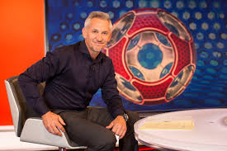
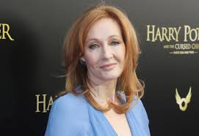
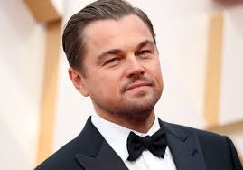
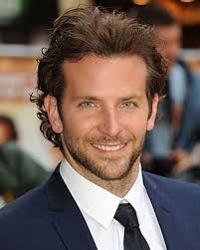
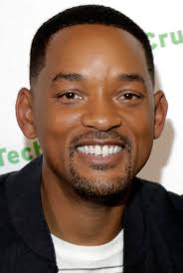
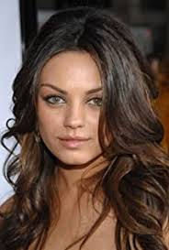
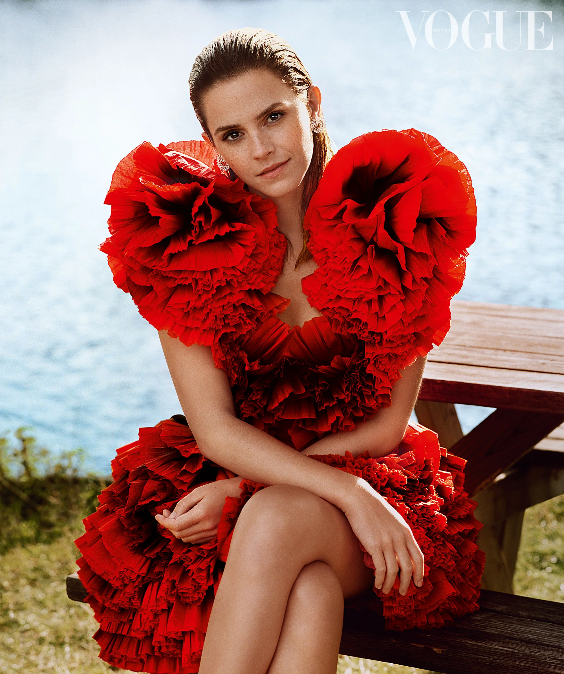
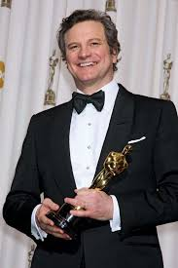
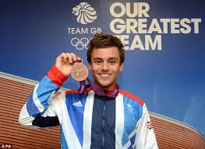
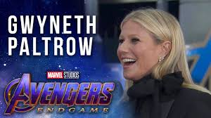
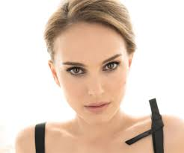
What can all of these
celebrities do…..?
Notes:
https://www.youtube.com/watch?v=bo_efYhYU2A

Slide 2




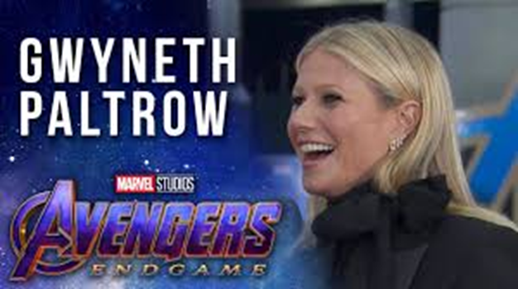
Watch these
clips to find out
https://www.bbc.co.uk/iplayer/episode/m000k4pp/celebrity-supply-teacher-series-1-6-gary-lineker-spanish
(From 01.36 to 02.20)
https://www.youtube.com/watch?v=2_v6HztMeU4 (up to 1min30)
https://www.youtube.com/watch?v=aLTXYP27b-I
(up to 0.38)
https://www.youtube.com/watch?v=f0K_dOEY6vU
(up to 0.43)

Slide 3
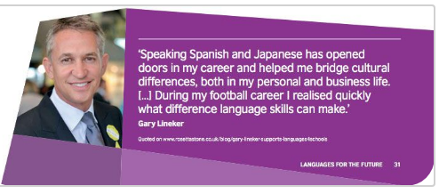

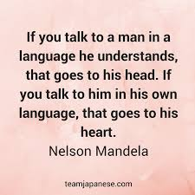
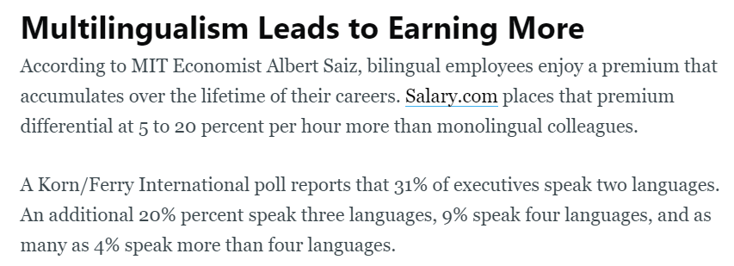
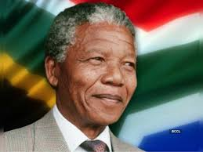
Why is important to speak another language?
https://www.youtube.com/watch?v=Y9u8Qbeig_Y
(up to 01.23)

Slide 4
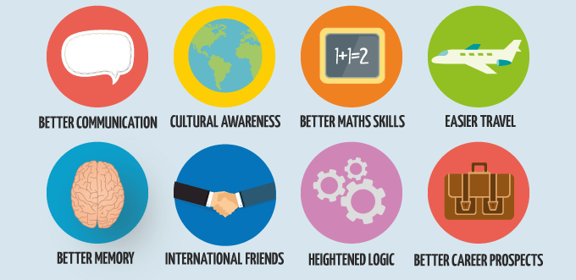
Skills you get from learning another language
Memory boosting
Improved communication skills
Improved self confidence
Improved listening skills
Help to improve your English
Increased understanding of
another culture
Increased employability
Notes:
https://www.youtube.com/watch?v=J0BPoofmPkw

Slide 5




Which subjects does MFL GCSE go well with?
English (learning French words will help your understanding of more complex words in English, as they’re often similar)
History (for your EBACC)
Geography (for your EBACC)
Remember an MFL GCSE makes you ‘stand out from
the crowd’ no matter which other subjects you take, and
makes you more attractive to Universities and employers.

Slide 6



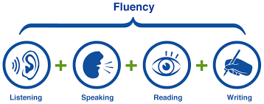

What does MFL GCSE look like?
AQA Exam Board
No coursework
2 tiers: Foundation and Higher
4 exams each worth 25% of your final grade:
Listening
Reading
Writing
Speaking
Re-designed GCSE Schemes of Work from 2020
Experienced teachers with examiner knowledge

Slide 7







Which topics do we cover at GCSE?
Theme 1 Identity and Culture
Me, my family and friends
Technology
Free-time activities
Theme 2 Local, international and global areas of interest
Where you live
Social issues
The environment
Theme 3 Current and future study and employment
School
Post-16 Education
Jobs

Slide 8
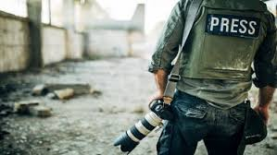
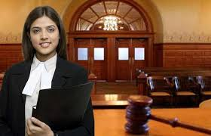
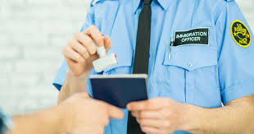

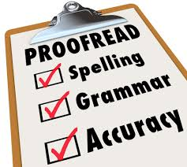
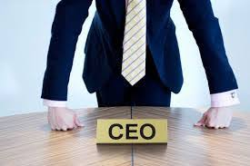

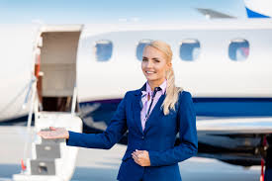



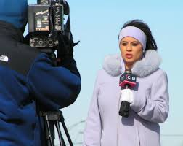

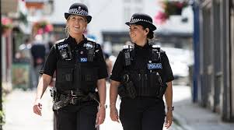

Careers which MFL GCSE is very useful for:
Law Publishing
Business Interpreting
Translation e.g games translator Business
Security service e.g MI5 Immigration
Teaching Airlines
Journalism Travel companies
Police
Social work

Slide 9

If you have any questions about MFL GCSE, speak to your class teacher or email Mrs Turner (Curriclum Leader)
turner.h@hungerhillschool.com

