Slide 1

Year 7 & 8 Reading
Competition 2021

Slide 2



Reading for 6 minutes per day can reduce stress by 68%?
Reading a little each day can help to make all of your subjects easier?
Short bursts of reading for fun can really help to improve your GCSE grades?

Slide 3

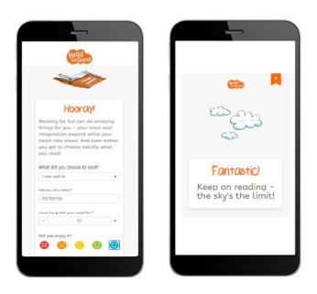
Introducing the Track My Read tracker…
This is SO achievable!
If you each read for 10 minutes per day, each day between now and Easter, your year group will smash our target and achieve over 100,000 minutes! Will you do it before Y7?!
We’ve set ourselves a reading target as a school, and we need you to help us SMASH IT!
The target for your year group is…..
60,000 minutes by Easter!

Slide 4
You’ll be given a unique URL link with a few short questions to complete each time you’ve spent some time reading for fun:
● Go to the unique link provided by the school (on any device with internet access)
● Bookmark or save the link so that you can easily use the link again and again
● Answer a few simple questions:
○ What did you choose to read? (from a dropdown list including audio book, comic, book etc.)
○ What's the title’?
○ How long did you read for?
○ Did you enjoy it? (a choice of 5 emojis)

Slide 5

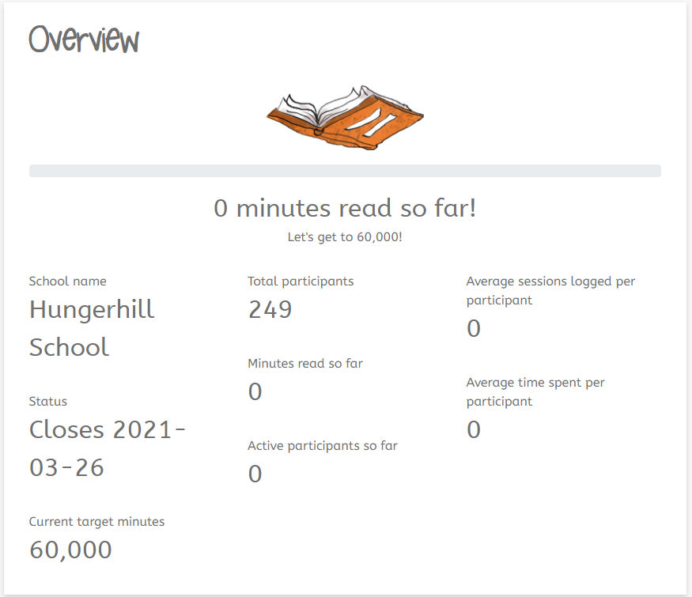
Your parents and teachers will be able to keep track of how your year group is getting on by using a link.
Your English teacher will give you updates of how your class is doing against the other classes – which class will read the most?!
Your target, as a year group is 60,000 words by Easter – can you do it and beat Y7?!

Slide 6

You are competing as a year group to get to 60,000 words before Y7 – MYSTERY PRIZE for the best year group!
You are also competing as an English class – can your group read more words per day each than the other classes (it doesn’t matter how many are in your class!)
You are competing as an individual – can you be crowned ‘Reader of the Week’ in your class? You might read the most words per day, or impress your teacher by improving the amount you’re reading the most.
Let’s look at what you can win…

Slide 7
Each week, prizes will be given for the following:
In each year group:
- English class of the week (most words read per person on average) = a text home per student
In each English class:
- Reader of the Week(teacher to choose) = A certificate and a text home

Slide 8



What else can you win?
Between now and Easter, if you…
Read for a total of 180 minutes (3 hours) = a text home
Read for a total of 240 minutes (4 hours) = a phone call home
1st prize = A Kindle
Read for a total of 300 + minutes (5 hours) = entry to the grand prize draw!
2nd prize = £30 Amazon voucher
3rd prize = £20 Amazon voucher
4th prize = £10 Amazon voucher

Slide 9
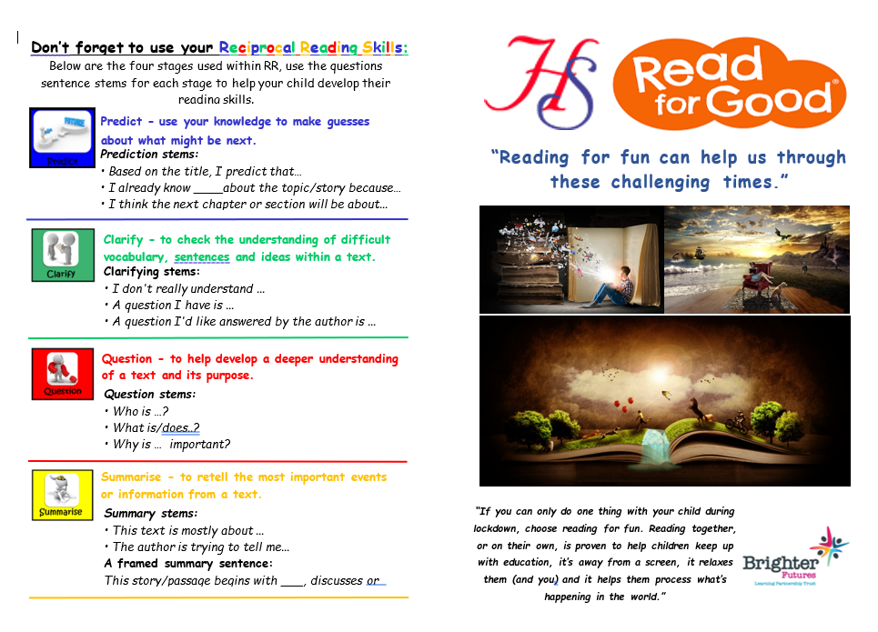
If you’re finding reading tricky, you can:
- use this digital help-book to remind you of some key strategies that we use at school
- ask a parent, guardian, friend or sibling to use the booklet to help you
- ask your English teacher for some tips!

